Slide 1
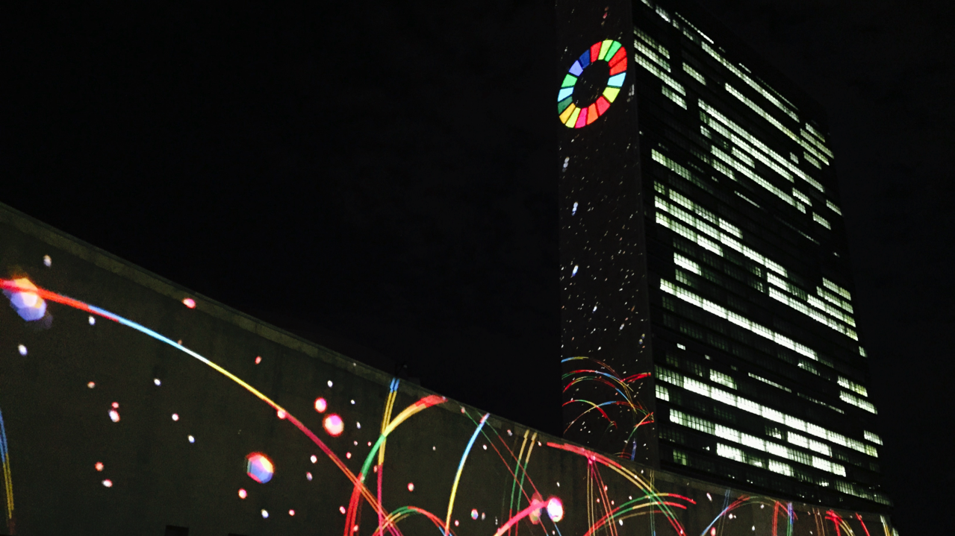
Sustainable Development Goals: A Blueprint for the World
Kaysie Brown
Special Advisor
kbrown@unfoundation.org
@kaysiebrown

Slide 2
United Nations Foundation: Mission and Role
To support and strengthen the United Nations as a platform for effective global problem solving
We connect people, resources and ideas
to the UN to address global challenges

Slide 3
UNF’s Approach
CHANNEL
CHAMPION
COMMUNICATE
CONVENE
COLLABORATE
We are a conduit for support and education for the UN
We champion the UN and its value
We promote the UN and UN causes
We align actors to further UN goals
We are a platform for alliances

Slide 4
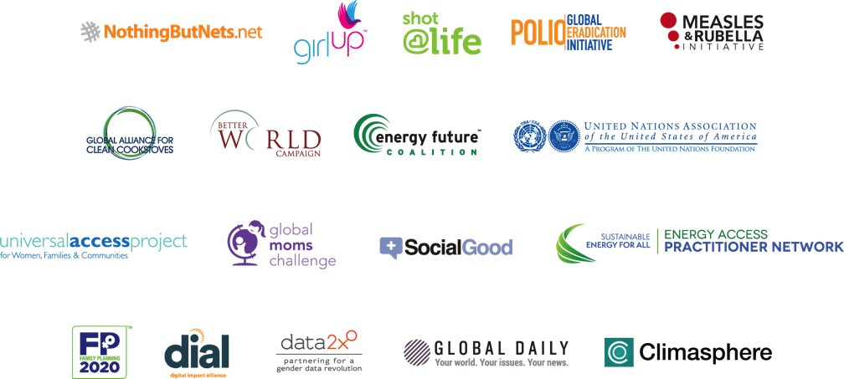
UNF’s Alliances & Initiatives

Slide 5
A brief timeline of global development & the Sustainable Development Goals
2000-2015:
Millennium Development Goals (MDGs) – 8 goals created by the United Nations to reduce poverty in developing countries over 15 years
2012-2015:
Post-2015 Development Agenda – UN, its member states, civil society, the private sector, philanthropy, and academia began planning for global development after 2015
2015-2030:
Sustainable Development Goals – 17 goals to provide a roadmap for eradicating poverty by 2030

Slide 6
Not Starting from Scratch: Building off of the MDGs
The MDGs showed that when we get to work & set goals for ourselves, progress happens…
Since 1990, child deaths and extreme poverty have been cut by more than half.
More kids are in primary school than ever before.
New HIV infections decreased by 35% between 2000-2015.
2.6 billion people have gained access to improved drinking water since1990.

Slide 7
Moving from MDGs to SDGs
Building off continued development priorities: poverty eradication, health, education and food security and nutrition
Expanded MDG agenda: poverty, food, land, jobs, youth, health, population dynamics, water, sanitation, energy, growth, trade, cities, transport, SCP, forests, oceans, biodiversity, finance, tech
Addressing underlying causes and existing challenges: Extreme poverty, inequality, climate change, peace and governance
Lack of data, measurement
Needing a development framework for everyone
Means of implementation

Slide 8
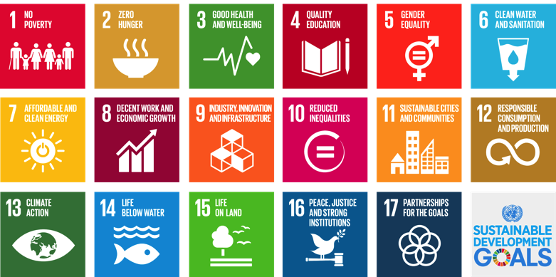
What are the Sustainable Development Goals?
17 Goals
169 Targets
231 Indicators
The world’s roadmap

Slide 9
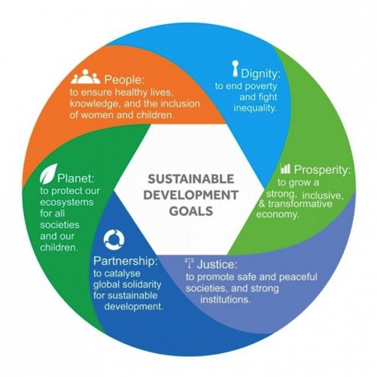
September 2015: 193 Countries Agree to the SDGs
World’s agreed framework for tackling interconnected economic, social, and environmental challenges across all countries…
…By 2030

Slide 10
New Approaches and Principles
They are ambitious: Unfinished business of the MDGs, and more
They are comprehensive: Economic development, human development, and environmental protection are linked
They are the people’s goals and country-owned: Created through the most inclusive process in UN history with input from more than 8 million people from across the globe
They apply to all of us: Relevant to all governments and actors, from Delhi to Detroit – not just for developing countries
They are interconnected: Reflect the complexity of the world we live in, thus balancing social, economic growth, and environmental protection
They are focused on ensuring “No One is Left Behind”: Push countries beyond averages to reach marginalized populations; SDGs should benefit everyone
They represent a new understanding of what works/financing: Move beyond foreign aid and ODA to partnerships, trade, investment, and domestic resource mobilization

Slide 11
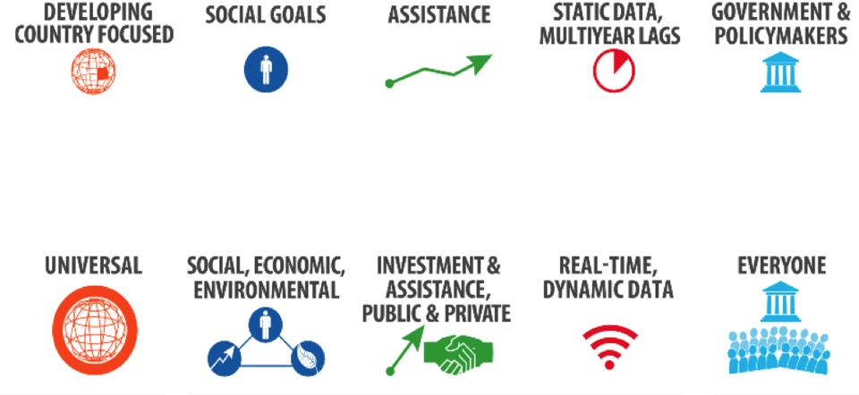
Why the Sustainable Development Goals are Exciting
Millennium Development Goals (2000-2015)
Sustainable Development Goals (2015-2030)
Source: U.S. Department of State graphic

Slide 12
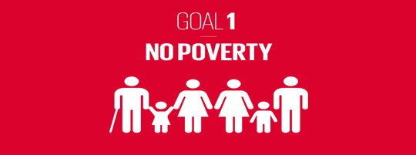
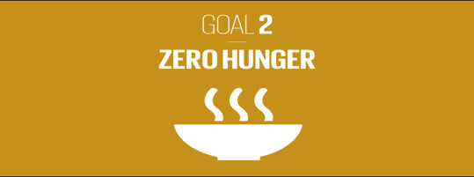
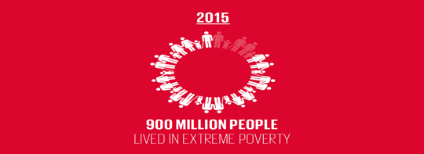
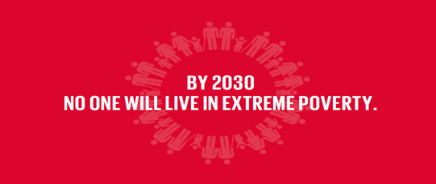
Global Goals Outcomes in 2030

Slide 13
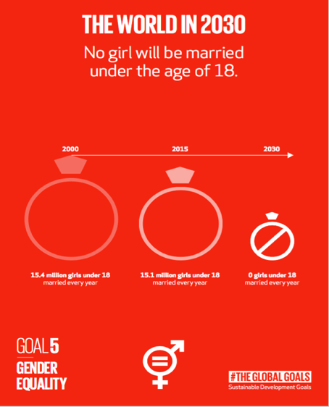
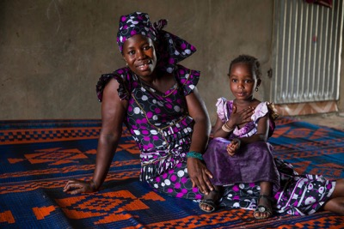
Global Goals Outcomes in 2030

Slide 14
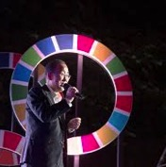
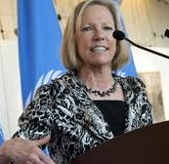
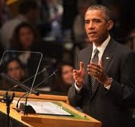
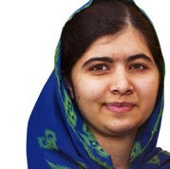
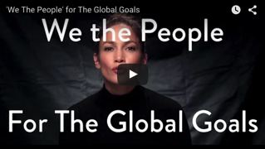
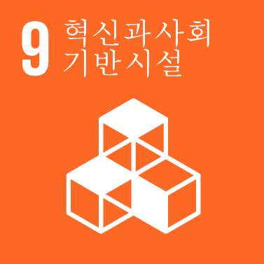
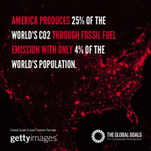
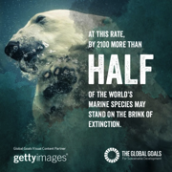
What Does it Take to Achieve the Sustainable Development Goals?
BUSINESS UNUSUAL: ACROSS SECTORS, ALL STAKEHOLDERS, NEW APPROACHES
Resources in the trillions
New technologies, solutions, innovations
Partnerships, from cities to multinational corporations
Markets, blended finance, policy
Data and evidence
Commitment to future generations
And importantly, continued awareness and education

Slide 15
One Year In: What is Being Done?
Governments as early leaders—mapping the SDGs into their national plans
Development actors building country capacities; supporting country-owned path; innovative financing
Civil society including youth are linking domestic and international approaches; advancing modern approaches to financing development
Philanthropic community aligning around the goals; partnering with others
Entrepreneurs and innovators as solutions makers toward sustainability
Cities embracing strategies and plans
Private sector including sustainability as core business practices, beyond CSR
Strengthen data production, access and use for decision-making and innovation

Slide 16
Early Mobilization & Upcoming Moments
Illustrative Platforms and efforts:
-Impact 2030
-Partnership for SDGs
-SDG Philanthropy Platform
-Business and Sustainable Development Commission
-UN Business Action Hub
-Global Partnership for Sustainable Development Data
Upcoming moments:
-UN General Assembly (September)
-Habitat III; World Food Day; World Polio Day (October)
-COP22; #Giving Tuesday (November)
-World AIDS Day (December)
-Year 2 SDGs (January 2017)
-International Women’s Day (March 2017)

Slide 17
Country Ownership & Kickstarting Implementation
High level government coordination: France, Germany, Japan, Mexico and the Republic of Korea initiated inter-ministerial coordination mechanisms
Planning: Madagascar’s National Development Plan for 2015-2019 incorporates the SDGs
Integration: Samoa determining how to synergize between policy areas, including sustainable development, climate change, resilience and infrastructure
Communications: Sierra Leone published a simplified version of the SDGs, and held workshops with local communities
Means of implementation: Madagascar reforming public finance management, supported by the IMF and others; preparing a medium-term strategy for domestic resources mobilization
Mainstreaming: Finland placed gender equality at the core of its approach to implementation
Inclusiveness: Norway engaging indigenous peoples’ assembly (the Sami Parliament) in formal SDG consultation mechanisms
Data and monitoring: Venezuela’s National Institute of Statistics disaggregating data about the most vulnerable

Slide 18
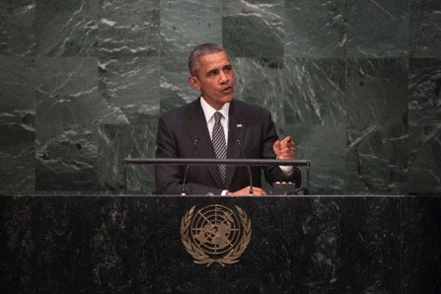
United States Leadership
“[W]e start by understanding that this next chapter of development cannot fall victim to the old divides between developed nations and developing ones. Poverty, growing inequality exists in all of our nations, and all of our nations have work to do. And that includes here in the United States…Here in this country, the wealthiest nation on Earth, we’re still working every day to perfect our union, and to be more equal and more just, and to treat the vulnerable members of our society with value and concern. That’s why, today, I am committing the United States to achieving the Sustainable Development Goals.”
President Obama, September 27, 2015
United Nations SDG Summit

Slide 19
United States & Implementation
USG-WIDE AND DOMESTIC
Convening inter-ministerial coordination meetings
Engaging domestic policy agencies to assess current progress to SDGs
Developing statistics that will be publicly accessible via a national reporting platform
Individual USG agencies embracing SDG framework into planning and programs:
Department of Justic
Interagency Council on Homelessness
Legislative support:
Global Food Security Act
Electrify Africa Act
US Cities’ leadership
Philanthropies involvement and education
DEVELOPMENT AND DIPLOMACY EFFORTS
USAID building country capacity to partner countries
Committing to diverse financing and partnerships
USAID and DOS underscoring SDGs for all overseas posts
USAID and DOS linking SDG framework to country-level strategic planning processes
Millennium Challenge Corporation compact development alignment
Championing data:
Global Partnership for Sustainable Development Data
The Global Open Data for Agriculture and Nutrition (GODAN) partnership; new data sets on health, gender, climate resilience and governance

Slide 20
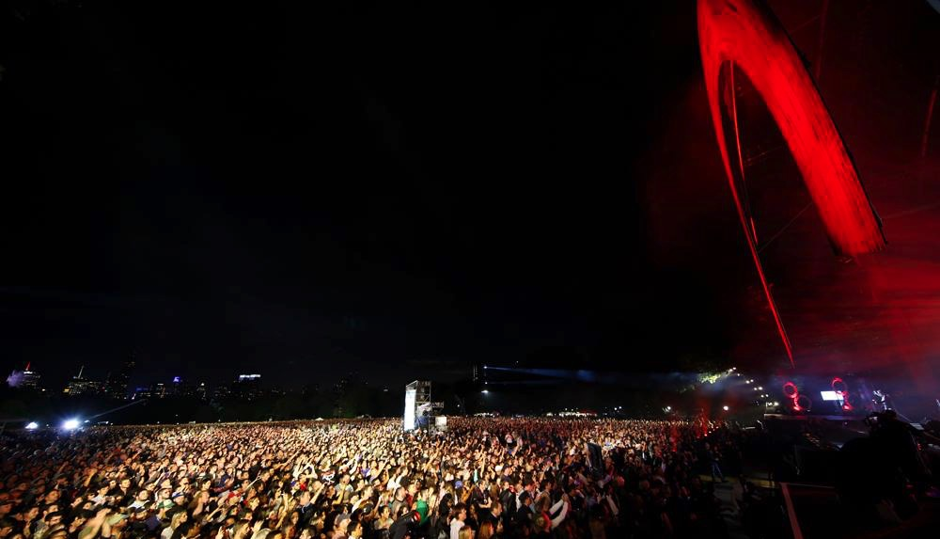
What can you do?
Tell Everyone about the #GlobalGoals
Champion a goal, or the entire agenda
Put the global goals emblem on your site to indicate your support
Embrace new and different partnerships; join platforms & engage the UN
Convene different actors; encourage industry-wide action in US and abroad
Measure and provide data on your programs within the SDG framework
Deliver technical expertise and knowledge
Focus on last mile populations and the “Leave No One Behind” agenda
Engage in the digital conversation and tie global goals to your work

Slide 21
Resources
Websites
www.globalgoals.org
UN Foundation: www.unfoundation.org
Project Everyone: www.projecteveryone.org
UNDP: www.undp.org/
SDG Philanthropy Platform: http://sdgfunders.org/sdgs/
Business and Sustainable Development Commission: http://businesscommission.org/
Impact 2030: http://www.impact2030.com/
Partnership for SDGs: https://sustainabledevelopment.un.org/partnerships/
Global Partnership for Sustainable Development Data: http://www.data4sdgs.org/
Social Media and Around Global Goals Week
Facebook
Global Goals: facebook.com/globalgoals.org
UNF: facebook.com/unitednationsfoundation
UNDP: facebook.com/UNDP/
Twitter
Global Goals: twitter.com/theglobalgoals
UNF: witter.com/unfoundation
UNDP: twitter.com/UNDP
Instagram
Global Goals: instagram.com/theglobalgoals/
UNDP: instagram.com/undp/
Introductory Readings
“The Sustainable Development Agenda: A Primer,” United Nations, 2016, http://www.un.org/sustainabledevelopment/development-agenda/
“Transforming our World: The 2030 Agenda for Sustainable Development,” United Nations, 2015, https://sustainabledevelopment.un.org/post2015/transformingourworld/publication
“The Sustainable Development Goals Belong to You,” Ban Ki Moon, LinkedIn Pulse, 2015,
https://www.linkedin.com/pulse/sustainable-development-goals-belong-you-ban-ki-moon
“Remarks by President Obama on the Sustainable Development Goals, 2015, https://www.whitehouse.gov/the-press-office/2015/09/27/remarks-president-sustainable-development-goals

Slide 22
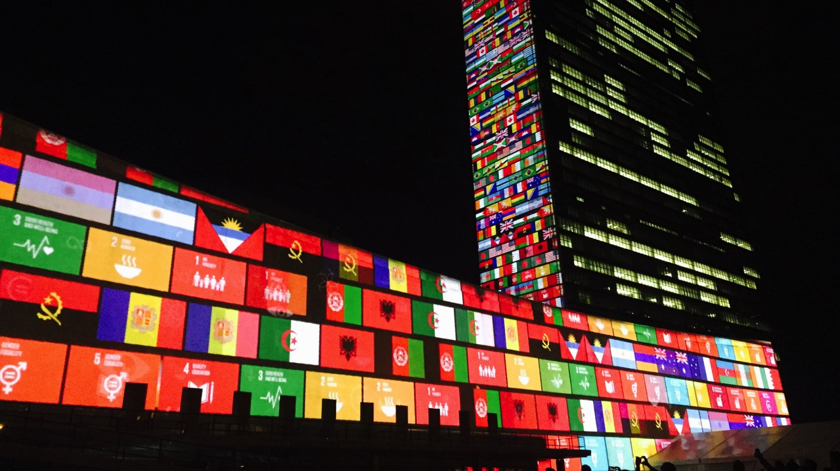
Learn more Tell everyone Take action
Follow: @unfoundation and @Post2015_UNF
Visit: www.sustainabledevelopment.un.org www.GlobalGoals.org

